Slide 1

Select Topics in Python Object-Oriented Programming
Notes:
‹#›

Slide 2

Objectives
Object-oriented programming
Introduction to object-oriented programming (OOP).
Difference between OOP and procedural-oriented programming.
Classes and objects.
OOP methodologies.
Notes:
‹#›

Slide 3
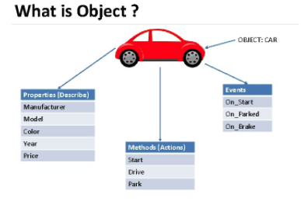
Introduction to Object-Oriented Programming (OOP)
Everything is an object.
New object classes can be easily defined.
Python programming is done in object-oriented fashion.
Example: car.
Notes:
Image from https://slidetodoc.com/2140705-object-oriented-programming-with-c-unit1-concepts/
‹#›

Slide 4
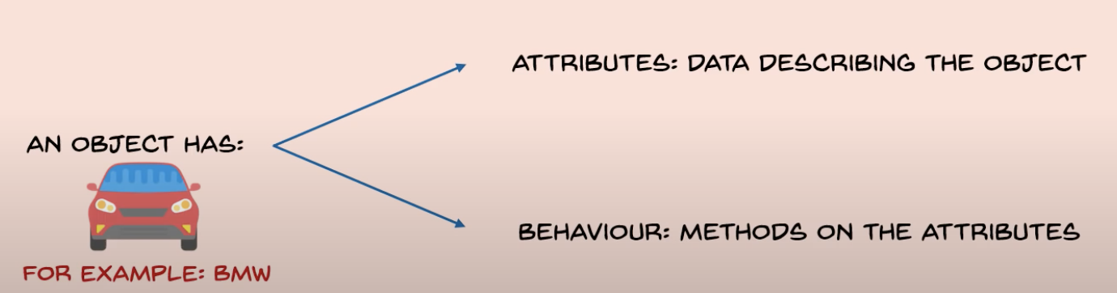
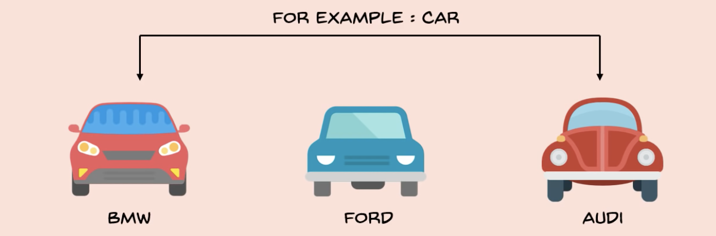
Introduction to Object-Oriented Programming (OOP)
Attributes.
Behaviors.
Classes.
Notes:
A class is a special data type which defines how to build a certain kind of object.
The class also stores some data items that are shared by all the instances of this class
Instances are objects that are created which follow the definition given inside of the class
Python doesn’t use separate class interface definitions as in some languages
You just define the class and then use it
‹#›

Slide 5
Notes:
‹#›

Slide 6
Select Topics in Python Object-Oriented Programming Part 2
Notes:
‹#›

Slide 7
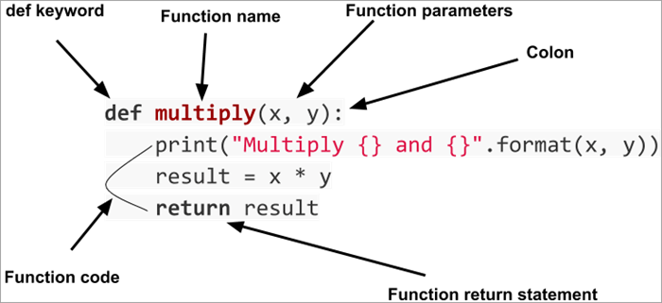
Introduction to Object-Oriented Programming (OOP)
Method Structure
def.
Function name
Function parameters
Function code
return
Notes:
The first argument of every method is a reference to the current instance of the class
By convention, we name this argument self
In __init__, self refers to the object currently being created; so, in other class methods, it refers to the instance whose method was called
Similar to the keyword this in Java or C++
But Python uses self more often than Java uses this
Although you must specify self explicitly when defining the method, you don’t include it when calling the method.
Python passes it for you automatically
‹#›

Slide 8
Introduction to Object-Oriented Programming (OOP)
Creating an object.
Constructor.
Overloading.
Args as alternative.
Assign the address of the object into the reference.
Ford = car()
Creates the reference variable.
Calls the constructor and creates an object.
Notes:
When you are done with an object, you don’t have to delete or free it explicitly.
Python has automatic garbage collection.
Python will automatically detect when all of the references to a piece of memory have gone out of scope. Automatically frees that memory.
Generally works well, few memory leaks
There’s also no “destructor” method for classes
Constructor method: a special method that is used when defining a class and it is automatically called when an object of that class has been created.
E.g., Ford = car() # This calls the constructor
In Python this method is named ‘init’.
Other languages may require a different name for the syntax but it serves the same purpose (initializing the fields of an object as it’s being created).
This method should never have a return statement that returns a value.
Should be (if return is needed) “return”
Never return a type e.g., return(12)
‹#›

Slide 9
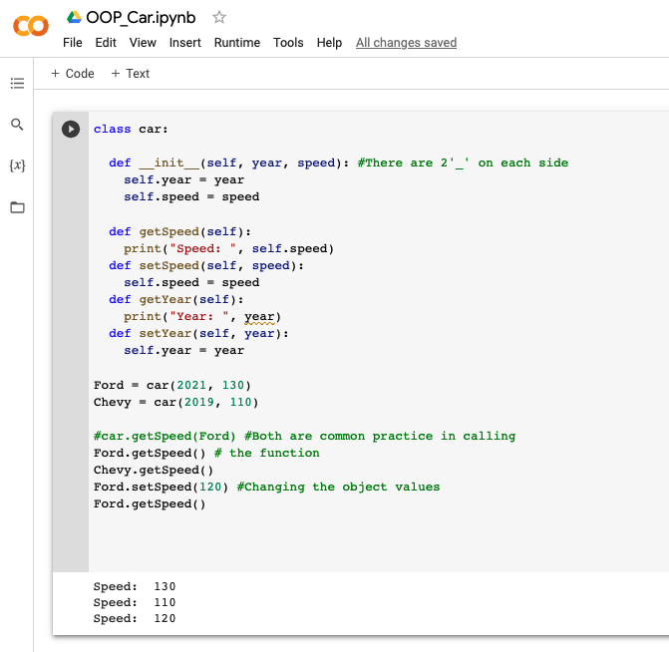
Introduction to Object-Oriented Programming (OOP)
Creating a class.
def = definition.
Creating methods.
Notes:
Similar to lists, objects are accessed through a reference.
Define a method in a class by including function definitions within the scope of the class block
There must be a special first argument self in all of method definitions which gets bound to the calling instance
There is usually a special method called __init__ in most classes
‹#›

Slide 10
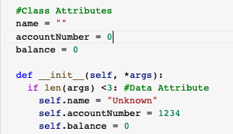
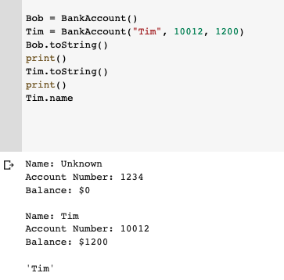
Introduction to Object-Oriented Programming (OOP)
Accessing method.
Accessing attribute.
Notes:
The non-method data stored by objects are called attributes
Data attributes
Variable owned by a particular instance of a class
Each instance has its own value for it
These are the most common kind of attribute
Class attributes
Owned by the class as a whole
All class instances share the same value for it
Called “static” variables in some languages
Good for (1) class-wide constants and (2) building counter of how many instances of the class have been made
‹#›

Slide 11
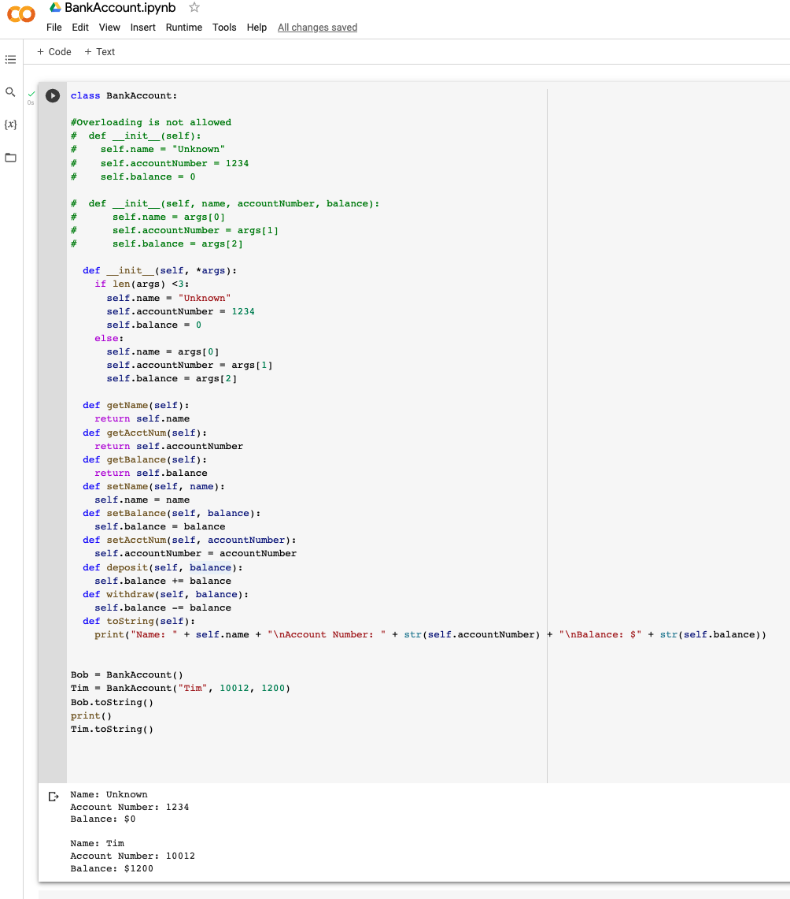
Introduction to Object-Oriented Programming (OOP)
OOP Example
BankAccount
Notes:
Class definitions are frequently contained in their own module.
A common convention is to have the module (file) name match the name of the class.
‹#›

